Slide 1
Telescopes

Slide 2
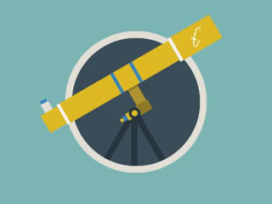
By the end of this lesson you should be able to:
• | State what a telescope is.
• | Explain how lenses and curved mirrors magnify objects.
• | Explain why space telescopes are so much better than telescopes on Earth.
• | Recall the key people who were involved in the development of telescopes.

Slide 3
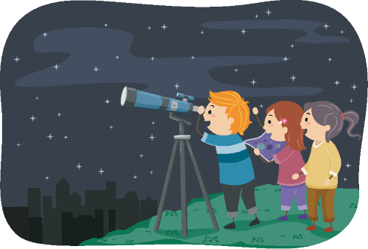
If you look up at the night sky, you can see many things including the Moon, stars, planets, meteors and comets using just your eyes.
But if you want to look more closely or see distant galaxies and planets outside our solar system, you need to use a telescope.
In this Smart Lesson, you will learn all about how telescopes were developed and how they help us see into deep space.

Slide 4
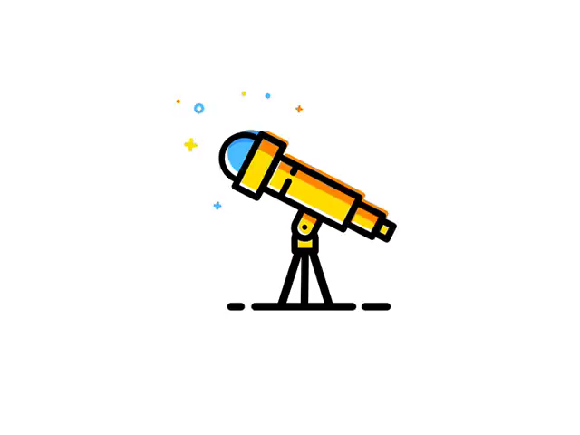
A telescope is an instrument that uses an arrangement of lenses and/or mirrors to make distant objects appear closer.
The word "telescope" comes from the Greek words "tele" (far) and "skopein" (to look or see).

Slide 5
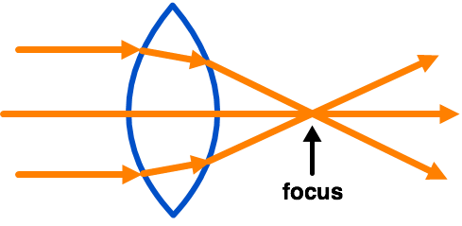
The further away from you an object is, the smaller it appears because less of its light is reaching your eyes.
In order to make distant objects appear larger and brighter, we need to magnify them. Lenses and curved mirrors can collect more light than your eyes can and focus the light on a certain point. A lens is a curved piece of glass.

Slide 6
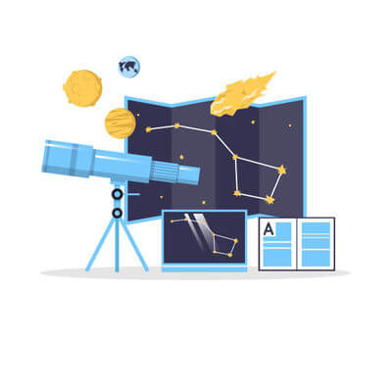
The size of the lens or mirror that is used to collect and focus the light from objects in the sky is very important.
The larger the lens, the more light can be collected and therefore the larger the field of view (how much of the sky you can see).

Slide 7
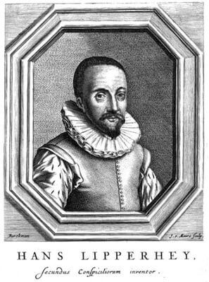
The earliest record of the design of a telescope was a patent application in 1609 by Hans Lipperhey, a Dutch eyeglass-maker.
Lenses made of glass were already being used to correct people's vision, and Lipperhey (along with other people) discovered that by combining different shaped lenses he could magnify far away objects.

Slide 8
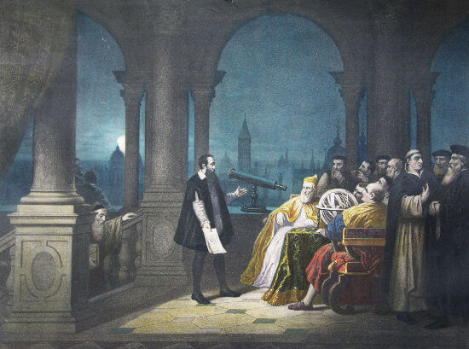
After hearing about Lipperhey's design, Galileo Galilei built a telescope in 1609.
He was the first person to point a telescope at the sky, and used it to observe the phases of Venus, four of Jupiter's moons and mountains and craters on the Moon.

Slide 9
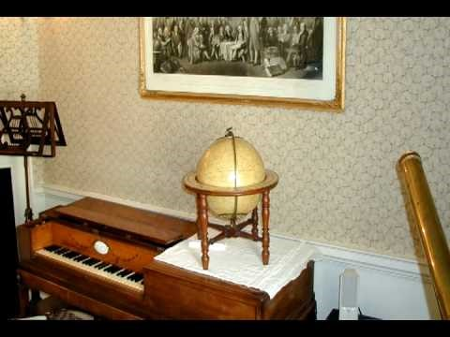

Slide 10
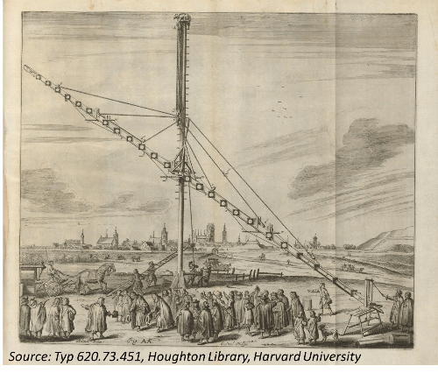
Johannes Kepler studied optics (the behaviour of light) and improved the design of the telescope by using different shaped lenses.
Kepler's design used a flatter lens which made the image clearer and enlarged the field of view (how much of the sky could be seen through the telescope).

Slide 11
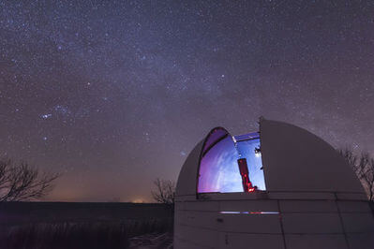
After studying Kepler's work, Isaac Newton found that using curved mirrors in telescopes worked better than using lenses, and he built a new type of telescope called a reflecting telescope in 1668.
This type of telescope is still widely used, and if you have ever looked through a telescope at an observatory, it was probably one of these!

Slide 12
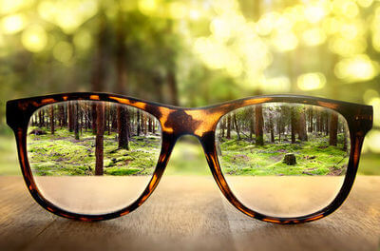
Why are mirrors so much better than lenses?
The main reason is that the lens or mirror must be exactly the right shape with a perfectly smooth surface so that the image does not get distorted.
Since lenses are made of glass and the light passes through them, the inside of the lens must also be perfect to get a good image.

Slide 13
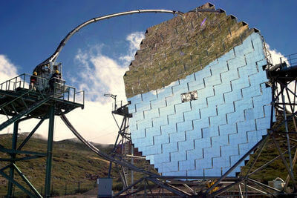
Remember, the larger the lens, the brighter the image will be, so to get the best images the lens must be very large.
But large lenses made of glass can be very difficult to get perfect, as well as being heavy!
Mirrors are better, since the light bounces off them so they can be very thin even if they are large. It is much easier to polish one mirror surface than to make a large, perfect lens!

Slide 14
In the 20th century, astronomers developed larger and larger telescopes to get better views of space.
Eventually, making the telescopes bigger no longer made the views better. This is because of Earth's atmosphere.
There are lots of tiny particles in Earth's atmosphere that scatter the light from the stars and planets, making the image more fuzzy. This is why stars appear to sparkle in the sky.

Slide 15
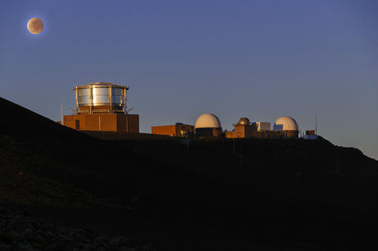
Think of this scattering of light like looking at something through a glass of water.
The image you see will not be very clear!
Large telescopes can be put at the top of mountains to get clearer pictures, because the atmosphere is thinner up there. However, the pictures still look fuzzy.

Slide 16
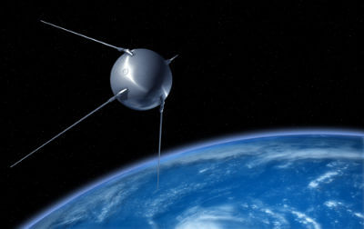
How could this distortion problem be solved?
In 1923, the German scientist Hermann Oberth first suggested launching a telescope into space to prevent Earth's atmosphere distorting the images.
However, his idea was not possible for many years. The first time a rocket was used to launch something into orbit wasn't until 1957.

Slide 17
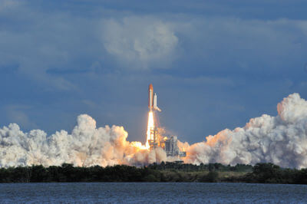
Hubble Space Telescope.
The idea became more realistic when rocket launchings became more common, and in the 1970′s the National Aeronautics and Space Administration (NASA) and the European Space Agency (ESA) began designing a space telescope. This would later be named the Hubble Space Telescope.

Slide 18
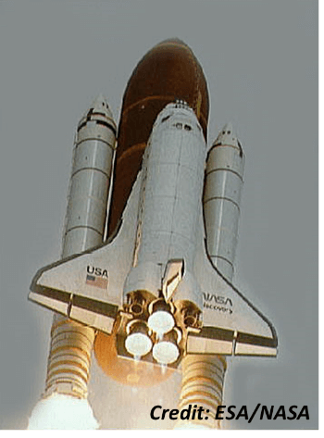
The Hubble Space Telescope was a major advance in observing the universe.
It was launched into orbit on April 24, 1990 by the space shuttle Discovery.
It orbits Earth about 600 km above the surface. Being outside of the atmosphere allows it to take very clear pictures of very distant places.

Slide 19
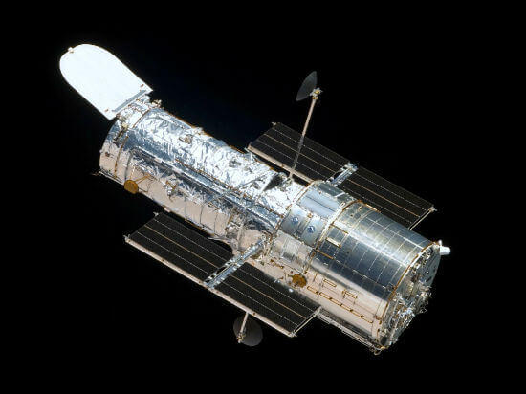
The telescope is 13.3 m long - about the same as a school bus - with a 2.4m wide mirror to capture light.
It is powered by four large solar panels which capture energy from the Sun, and it moves at over 27,000 km/h! This means it orbits Earth once every 97 minutes.

Slide 20
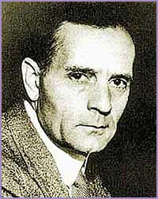
The Hubble Space Telescope was named after the astronomer Edwin Hubble.
Hubble (1889−1953) made some of the most important discoveries in astronomy, such as realising that there were other galaxies beyond our own Milky Way.
He also showed that the further away a galaxy is from Earth, the faster it appears to be moving away from us.

Slide 21
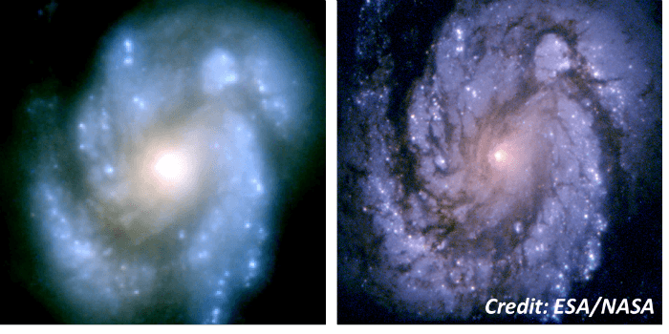
The Hubble Space Telescope is one of the largest and most versatile space telescopes in existence.
It was designed to be modified and fixed while in orbit, which is lucky because its main mirror had a defect that meant the first images it sent back were fuzzy!

Slide 22
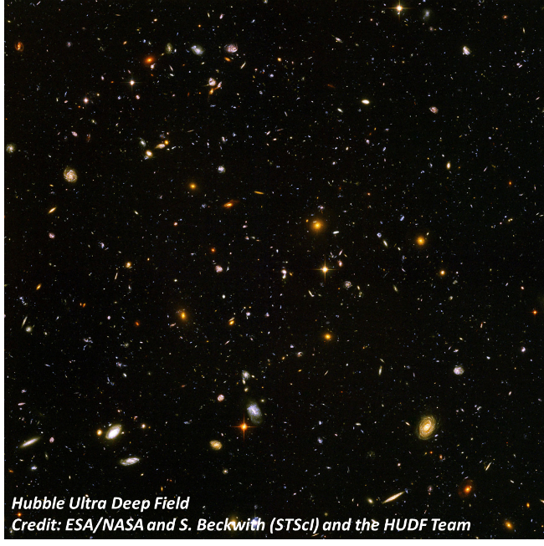
The Hubble Space Telescope has since revealed more information about the planets, galaxies and entire universe than had ever been observed before.
It was one of the most significant advances in astronomy since Galileo built his first telescope.
For example, the image below was taken when pointing the Hubble Space Telescope at a patch of sky that appeared empty when viewed from Earth.

Slide 23
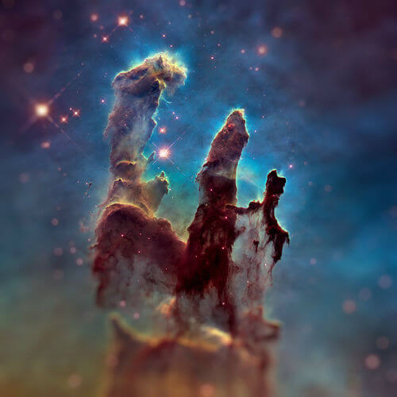
Hubble has revolutionised astronomy in many ways.
It can look deep into space to capture things Galileo and Kepler only dreamed of.
One of the most famous shots ever taken by Hubble, known as "The Pillars of Creation". These three giant columns of gas are part of the Eagle Nebula where many new stars are being born.

Slide 24
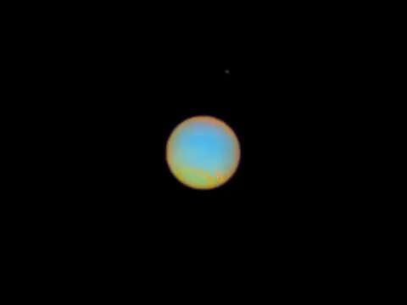
Footage from the Hubble Space Telescope helped scientists discover a new moon orbiting the planet Neptune in 2013.
This image shows Neptune with 4 of its 14 orbiting moons visible.

Slide 25
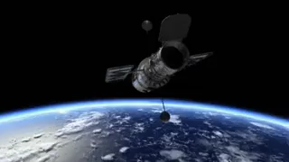
Sadly, NASA discontinued their space shuttle program in the early 2000s, and since then the telescope has received just one, final, servicing mission.
It is expected to operate until around 2040, at which point it will be removed from orbit.

Slide 26
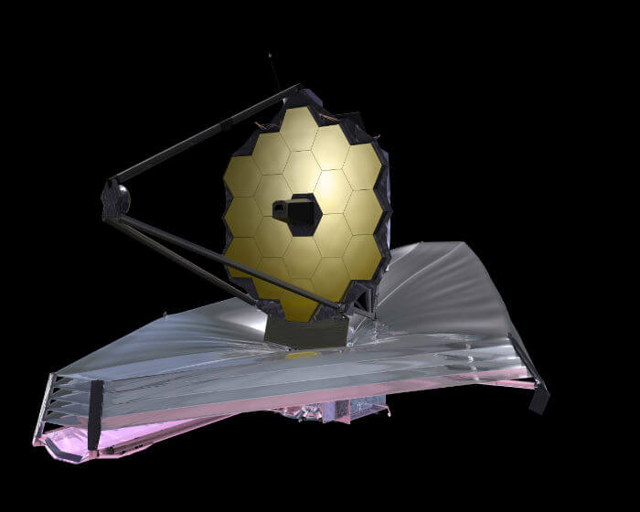
However, this is not the end for space telescopes!
A bigger, better replacement is being created - the James Webb Space Telescope. It is hoped to launch in 2021, and will analyse infra-red radiation from across the universe.

Slide 27
